Slide 1
Multi-task learning for astroparticle physics SOS 2021 Thomas Vuillaume, Mikael Jacquemont

Slide 2
Plan and objective for today
Objective: see an example of real-life machine learning project
How the problem is adressed
What is the analysis chain
Technological choices
Plan
Introduction on multitask learning
CTA and the event reconstruction
A standard approach
Multi-task deep learning
Application to CTA

Slide 3
Run it yourself
For the demo part, you may run the code yourself. All the content is openly available at:
https://github.com/vuillaut/cta_mtl_course

Slide 4
Multitask learning
An intro

Slide 5
Multitask learning
DATA
model
prediction
Reduces a loss function

Slide 6
Multitask learning
DATA
model
prediction
Reduces a loss function
Single task learning
Multi-task learning
Data
Data
Model 1
Model 2
Model 3
MT Model
Task 1
Task 2
Task 3
Task 1
Task 2
Task 3

Slide 7
Multitask learning
What : learning to predict multiple outputs that have some sort of relationship between them
Learning a specific task might help learning a related but different task
Happens in Human learning too
Learning to dissociate between sounds will help recognize people from their voice
Or waxing a car will help to learn karate…
Caruana, R. Multitask Learning. Machine Learning 28, 41–75 (1997). https://doi.org/10.1023/A:1007379606734

Slide 8
Why does it work?
Implicit data augmentation
Attention focusing: having more tasks help focusing on relevant features
Regularization: the model generalizes better (avoid overfitting)
Improves cross-tasks coherence
Exemple: predicting animal type and its color, you (probably) want to avoid the possibility to predict green cats

Slide 9
When does multitask makes sense
Training on a set of tasks that could benefit from having shared low-level features
You lack data for a specific task but have a lot of data for another related task
Not limited in the size of the model you build (otherwise can face negative transfer)
It is different from transfert learning but can help in similar ways

Slide 10
Auxilliary tasks
Auxilliary tasks are tasks that are not the main goal you are trying to solve but add because they can help you reaching that goal
Assumes that the tasks are related
Enables the model to learn representations that are shared or helpful for the main task
Examples:
Predict road characteristics to predict the steering direction of a self-driving car
Estimate head pose for facial landmark detection
Learning depth perception will help catching an object

Slide 12


Slide 13
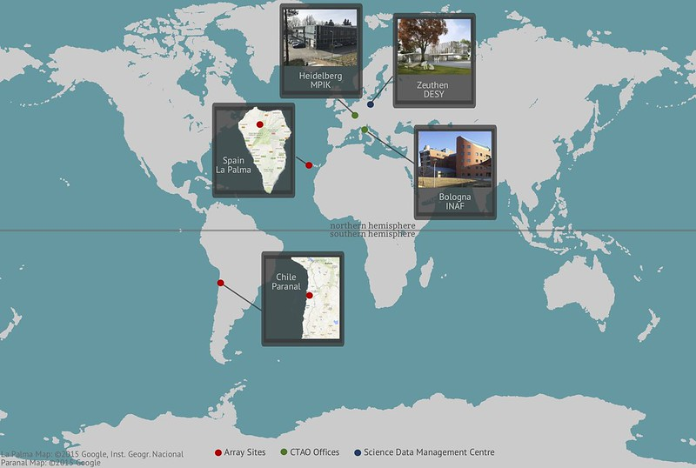
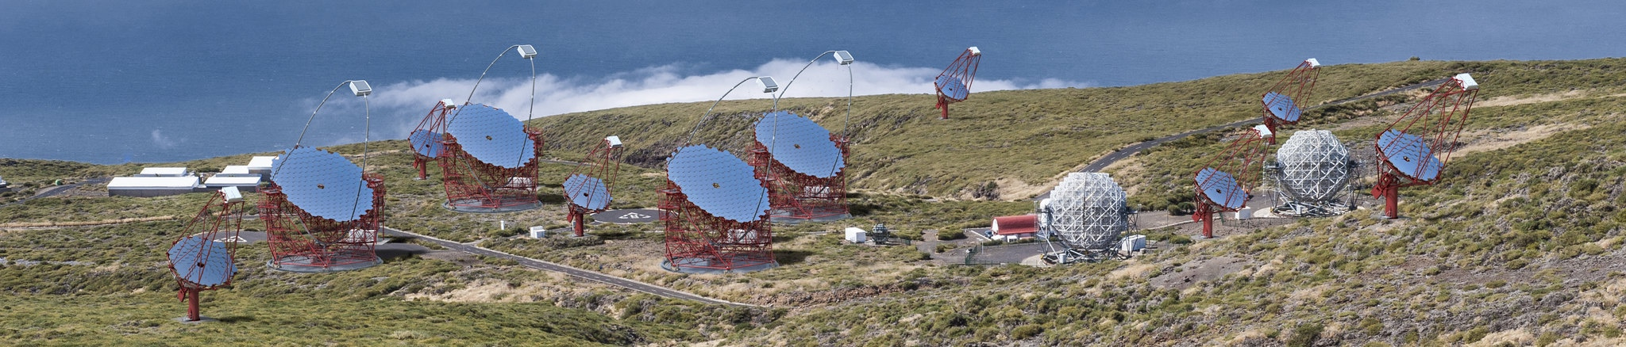
The Cherenkov Telescope Array
2 sites, > 100 telescopes

Slide 14
The Cherenkov Telescope Array
2 sites, > 100 telescopes
Observe the sky from 10GeV to 200 TeV
Sensitivity x10 compared to current generation of instruments

Slide 15
The Cherenkov Telescope Array
2 sites, > 100 telescopes
Observe the sky from 10GeV to 200 TeV
Sensitivity x10 compared to current generation of instruments
Observatory – sending and receving alerts from other infrastructures

Slide 16
The Cherenkov Telescope Array
Data analysis challenges:
Several types of telescopes and cameras
Data flux for real time analysis: ~5GB/s/camera
Data volume: 3PB/year (after volume reduction)

Slide 17
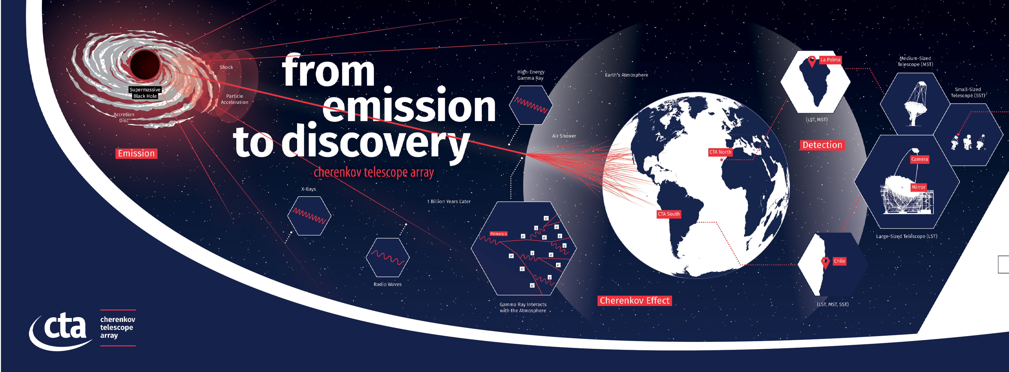
From emission to discovery

Slide 18
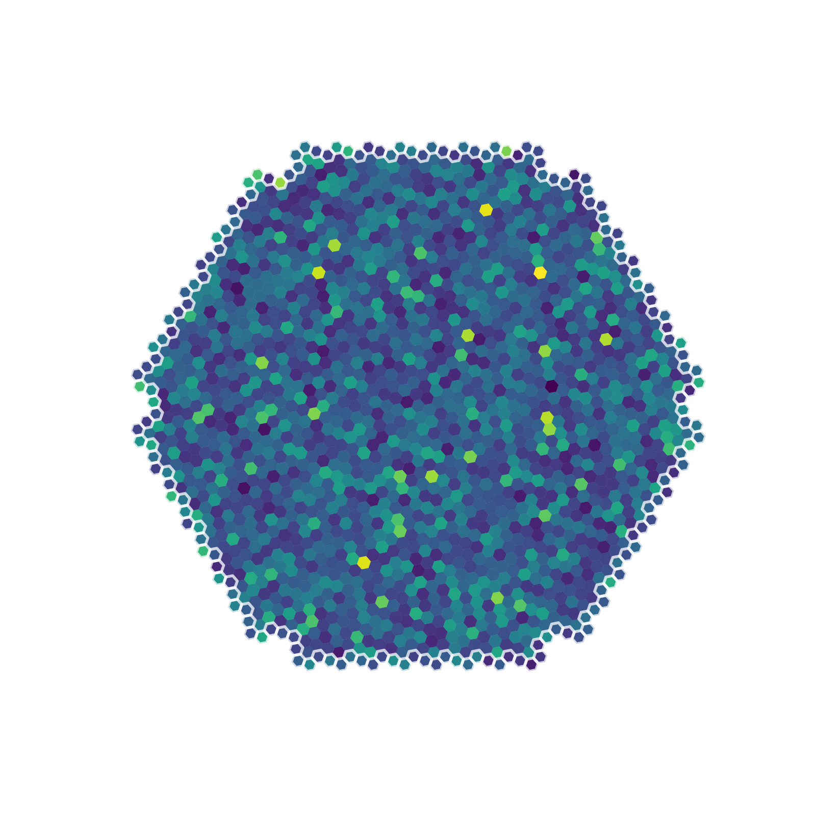
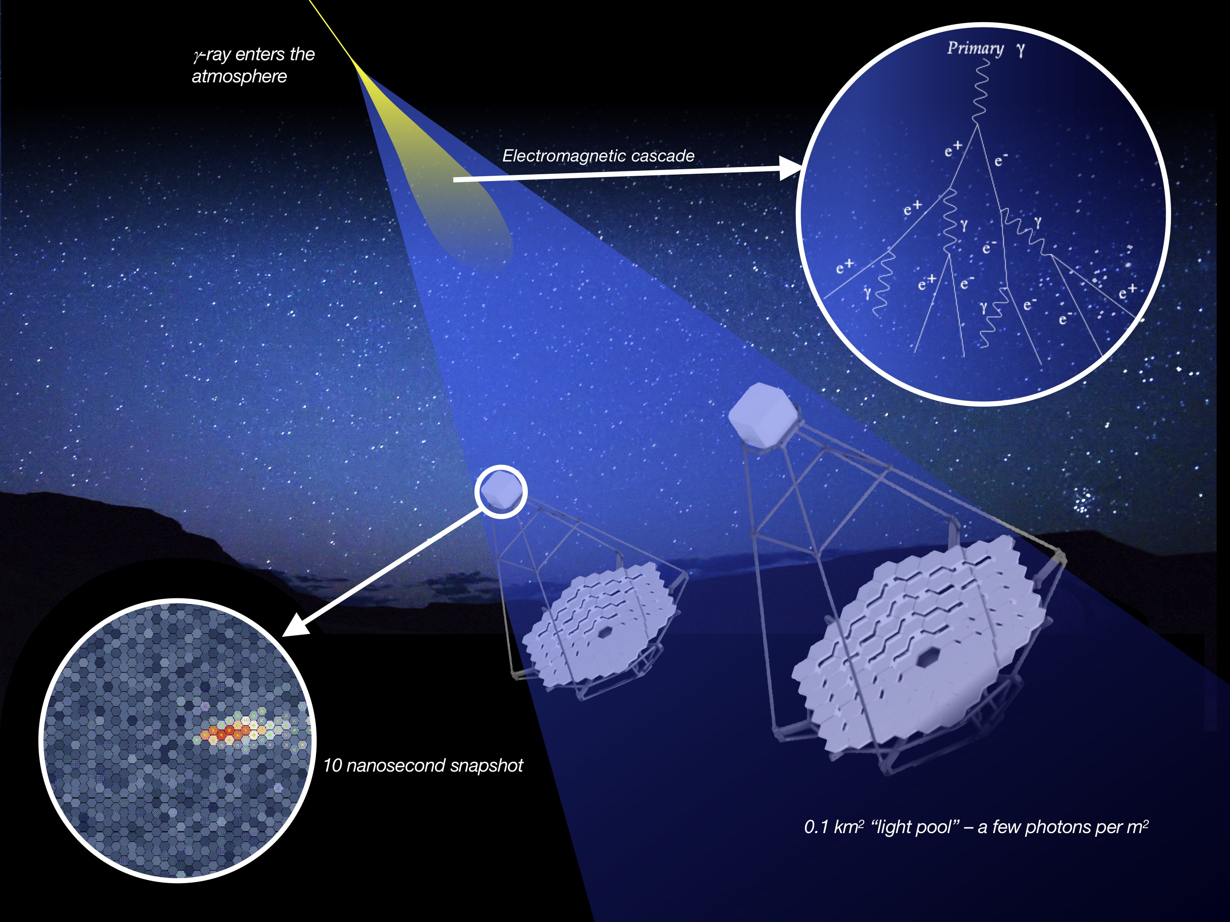
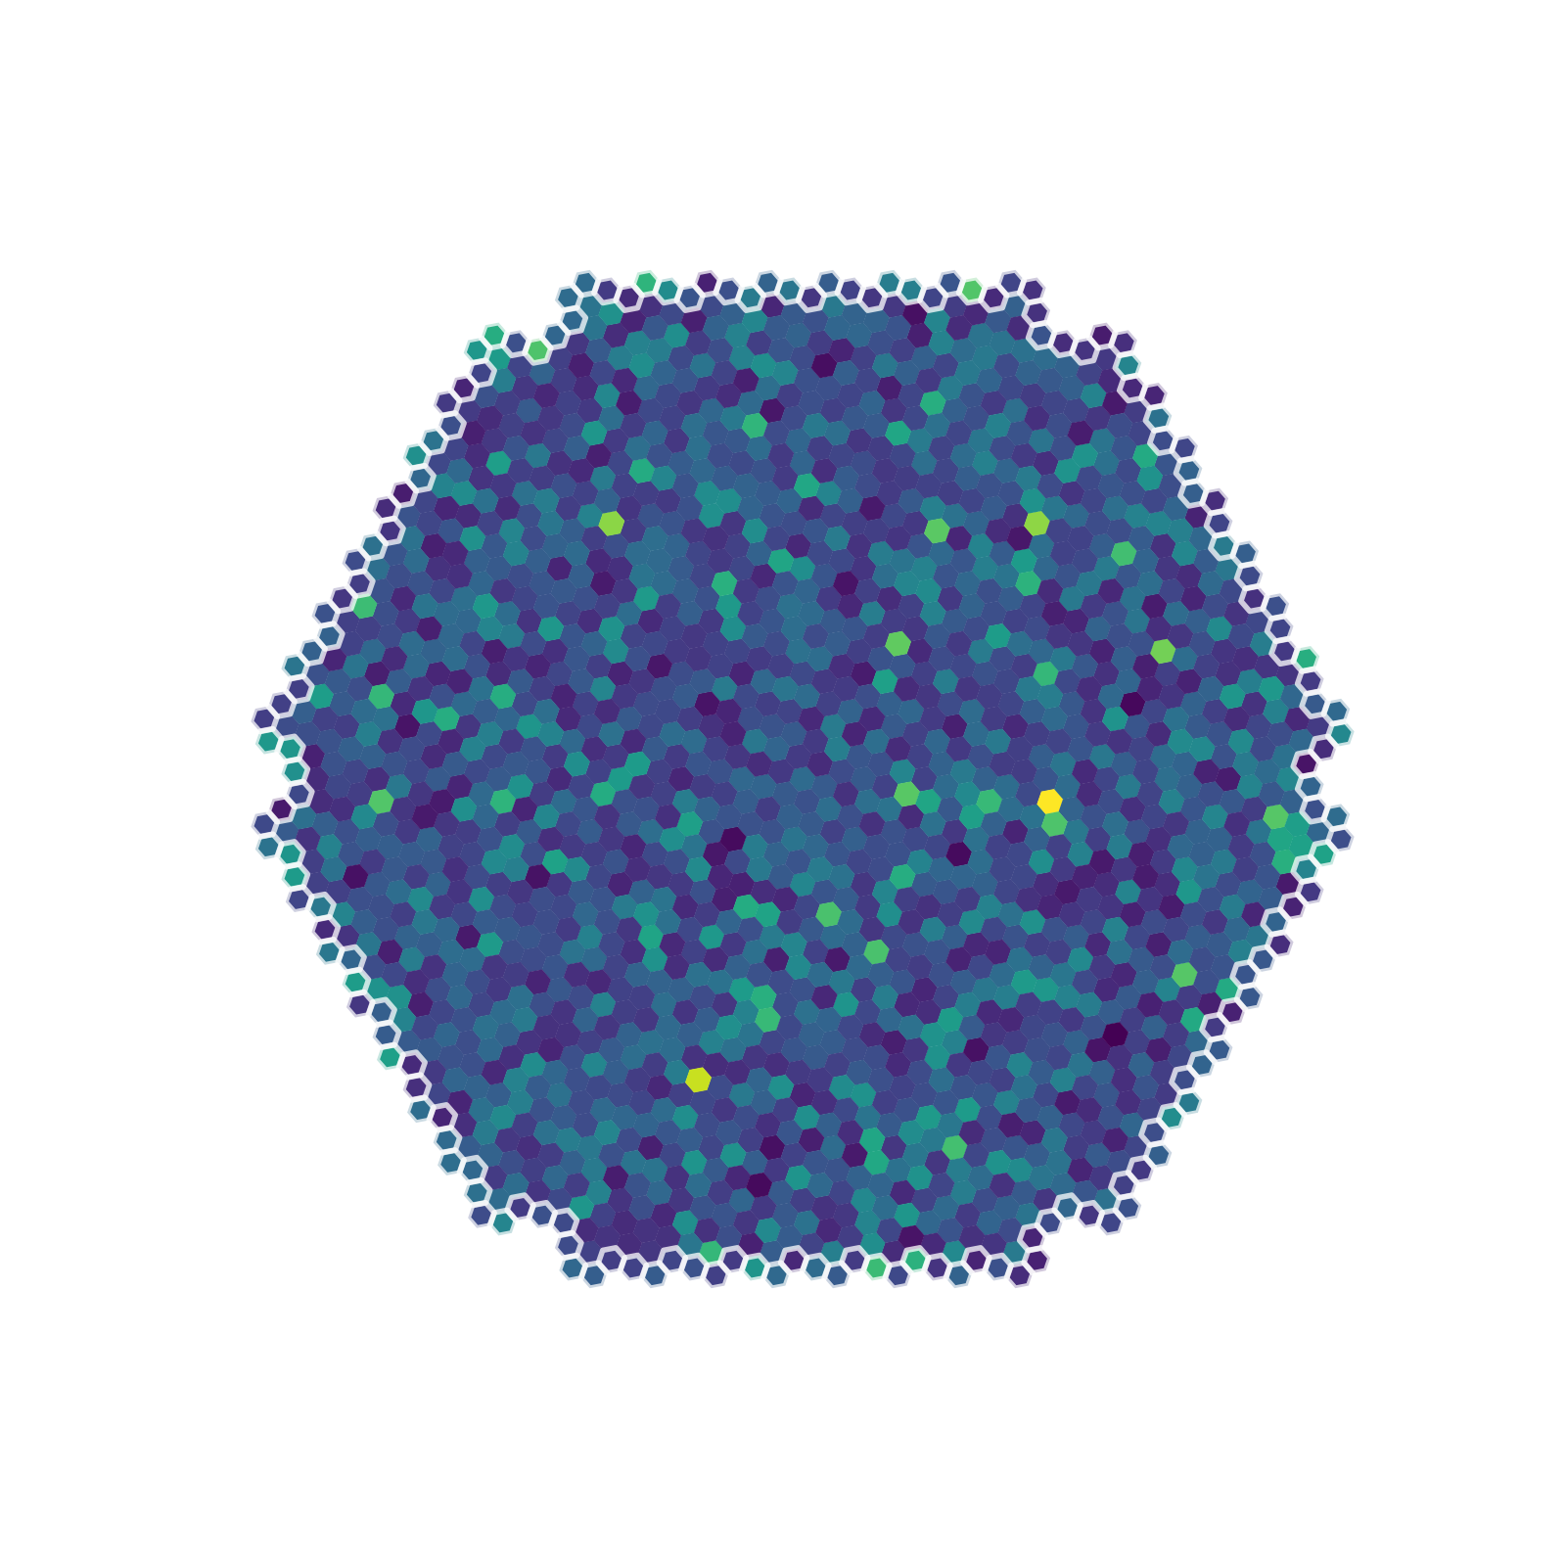
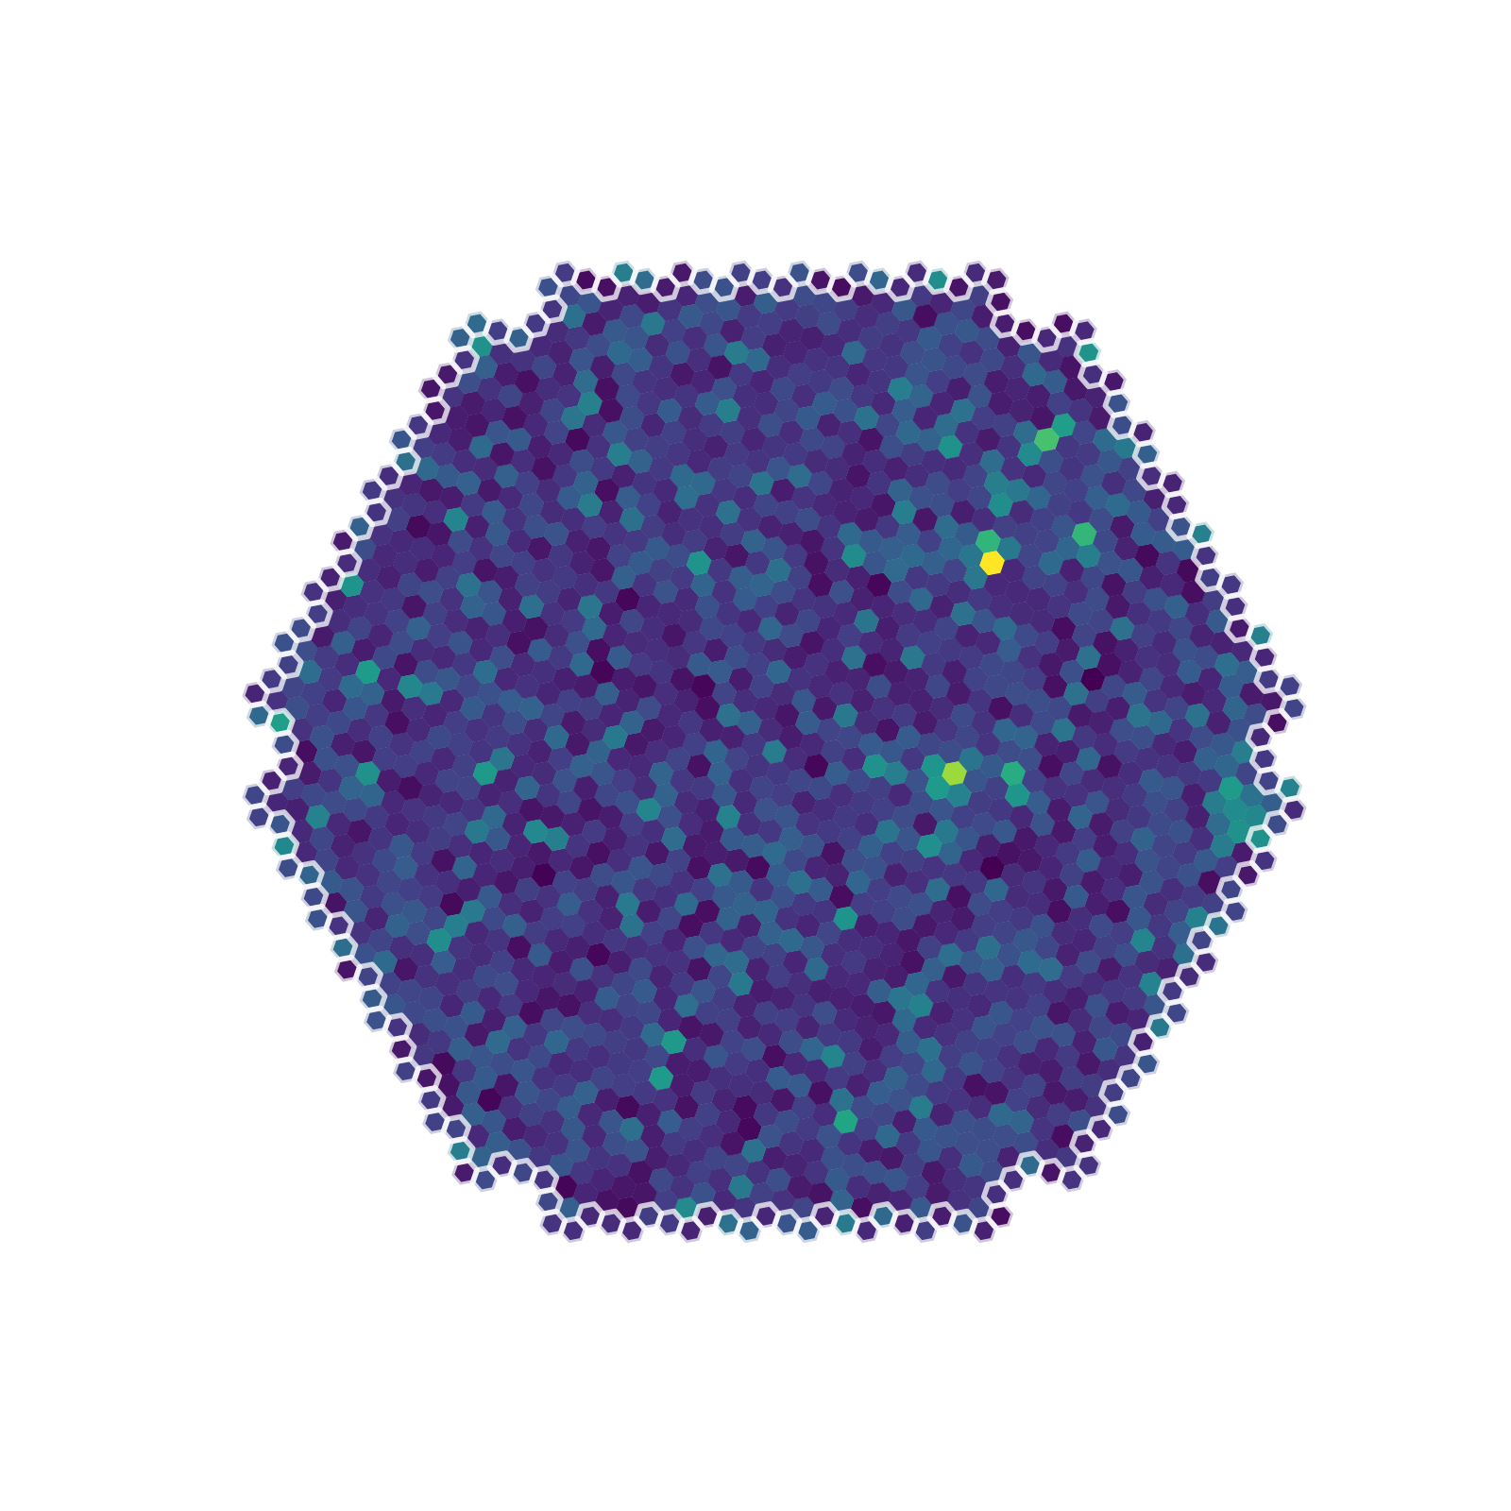
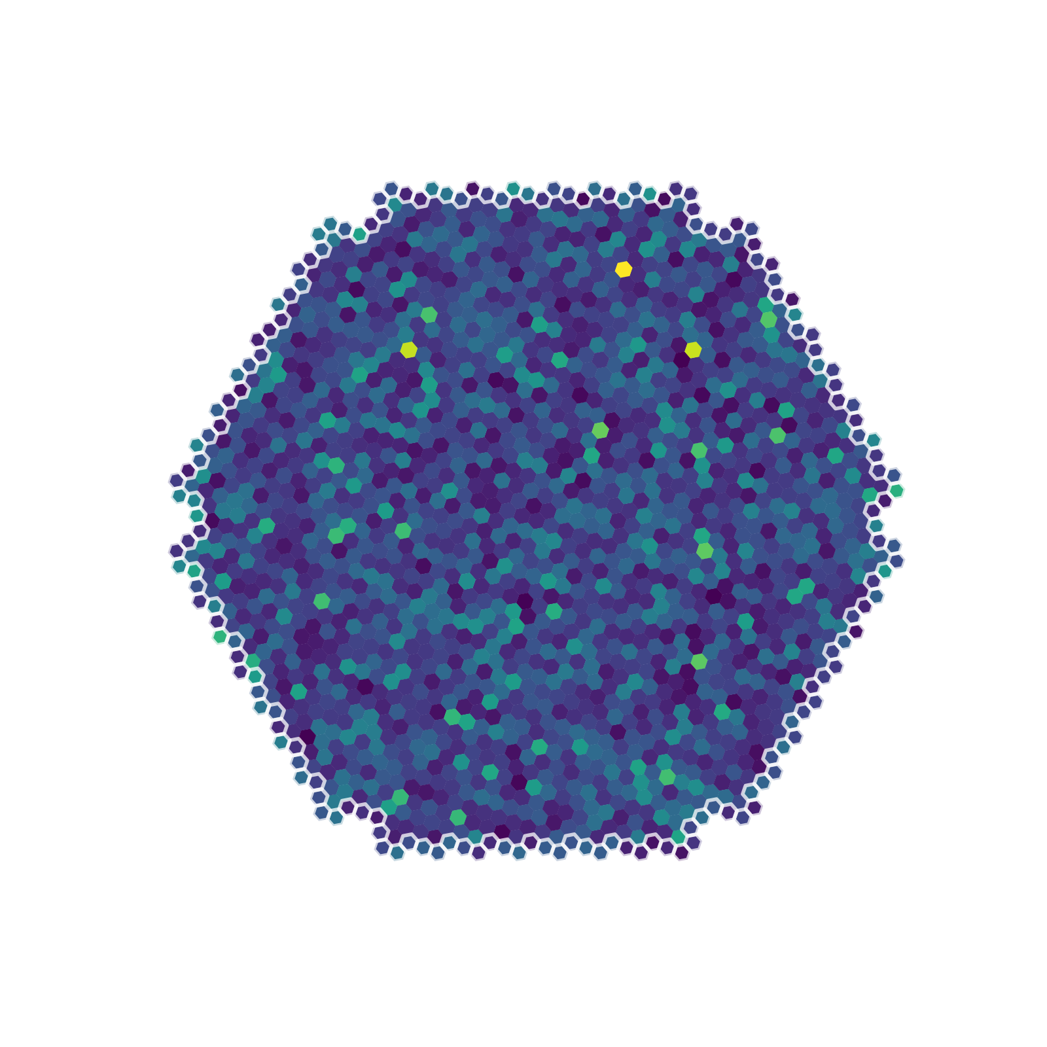
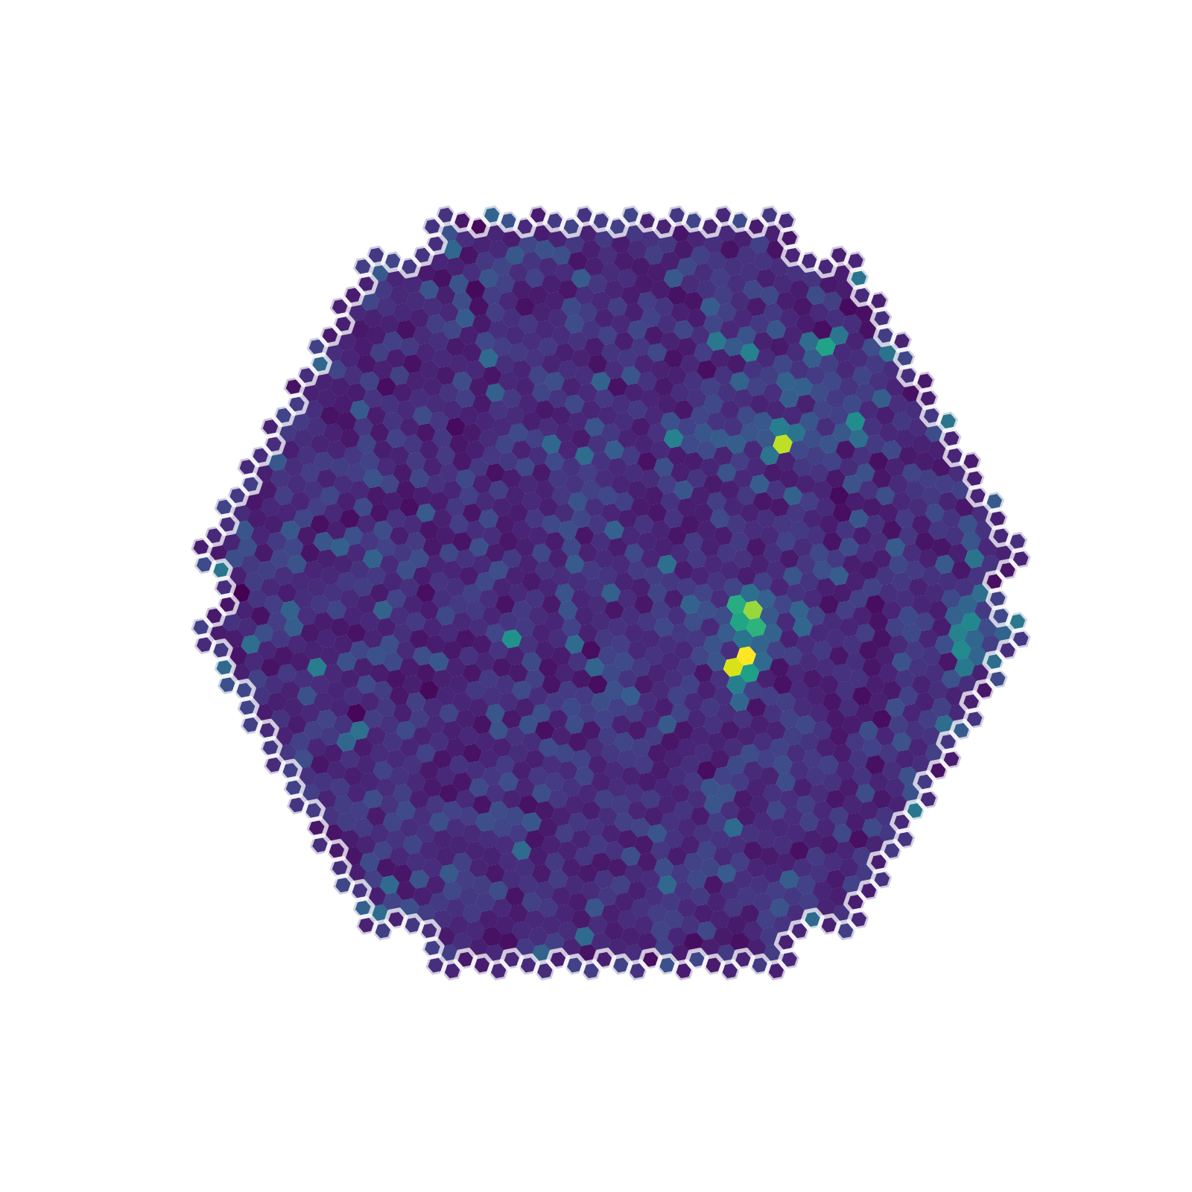
How does it work?
time
(40 x 1ns)
Évènement gamma
E = 0,189 TeV
Direction = (1,23; 6,22)rad

Slide 19
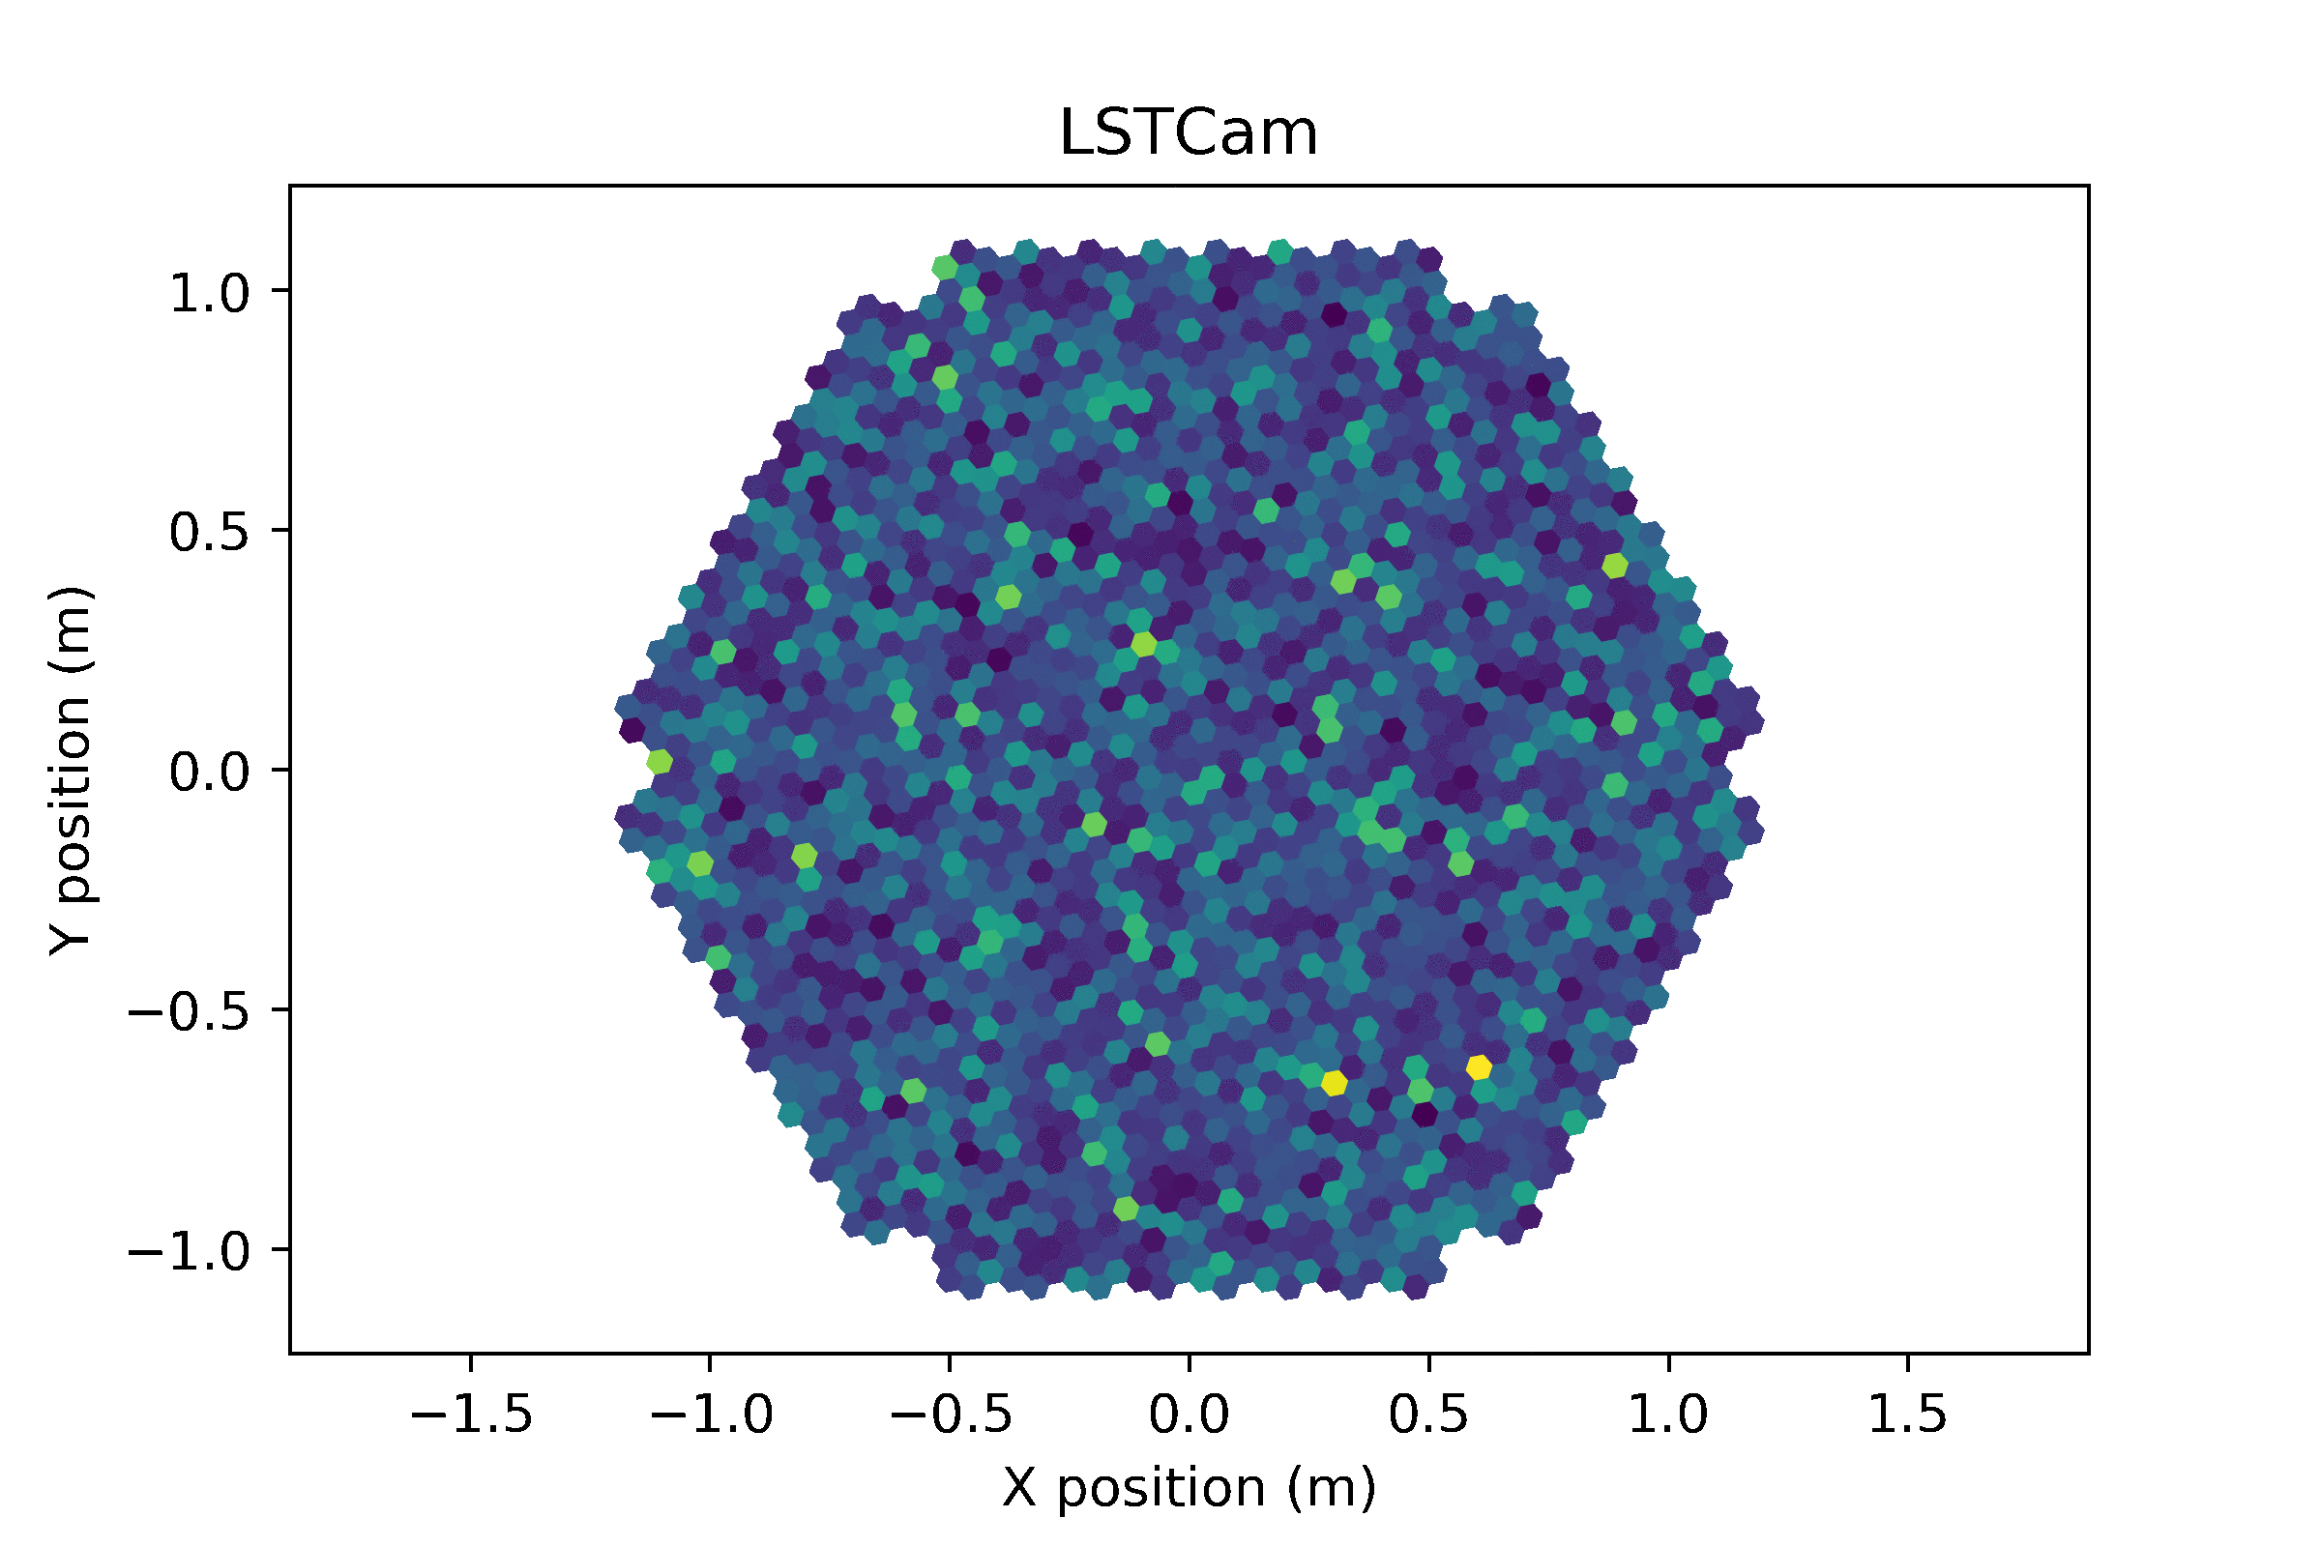
The problem
Évènement gamma
E = 0,189 TeV
Direction = (1,23; 6,22)rad
?

Slide 20
The standard approach

Slide 21
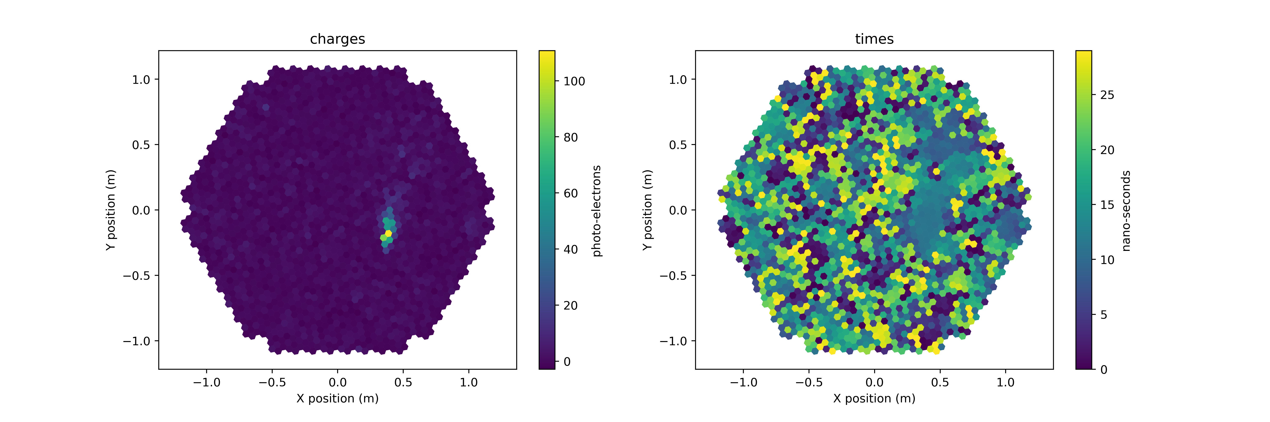
1. Signal extraction: calibration and integration
The signal in each pixel is integrated to max signal/noise ratio
signal
time
We get 2 images: the integrated charges and the photons mean arrival time

Slide 22
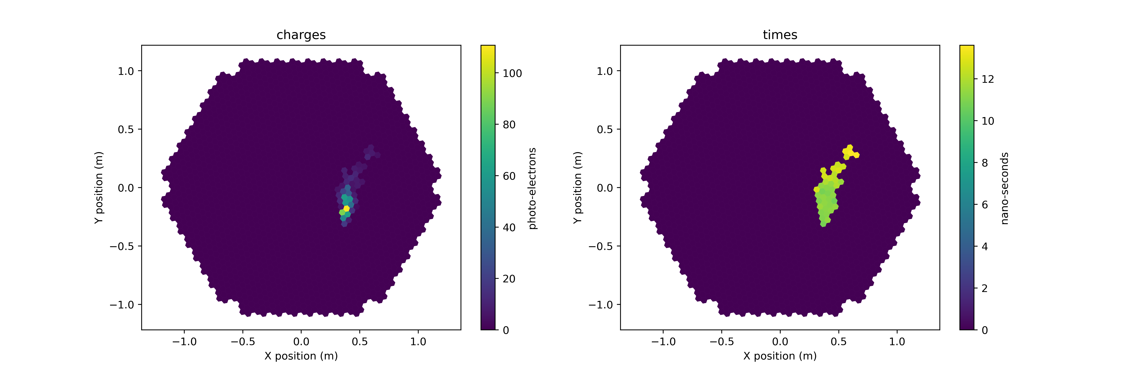
2. Parameters extraction
Clean images
Compute some charactersitic parameters of the signal:
size of the ellipsoid, position in the camera, signal intensity, axis orientation, time gradient….

Slide 23
Train random forests or BDT on Monte-Carlo simulations
Image parameters
E = 0,189 TeV
And then infer on new data

Slide 24
alt
az
E
type
?

Slide 25
Parallel approach
regression
Alt
Advantages:
simple
can run in parallel
regression
Az
regression
E
Drawbacks:
4 models to train/use
Reconstruction degeneracy
classification
Type

Slide 26
A serial approach
Advantage:
less degeneracy
Drawback:
slow
Alt
Az
E
Type

Slide 27
A mixed approach
alt
az
Advantage:
Take the physics into consideration
Drawback:
More complicated?
E
type

Slide 28
Adding intermediate parameters
hmax
Xcore
Ycore
Advantage:
More powerful
Drawback:
More complicated
Heavier
alt
az
E
type

Slide 29
DEMO #1
See notebook random forests

Slide 30
The deeper approach

Slide 31
More abstraction
Starting from raw data

Slide 32
Multi-task deep learning

Slide 33
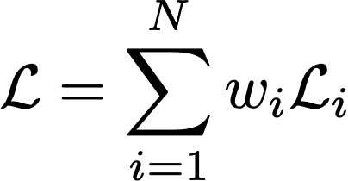
Hard parameter sharing
First idea: Caruana, R. "Multitask learning: A knowledge-based source of inductive bias." Proceedings of the Tenth International Conference on Machine Learning. 1993.
Hidden layers common to all task
Task-specific output layers
Advangtage:
Common representation of the data
Reduces risk of overfitting (of an order ~ number of tasks*)
The more tasks, the more general the model has to become
Drawback:
The tasks must be physically related (negative transfert)
Requires some level of knowledge/understanding of the problem complexity
*Baxter, J. (1997). A Bayesian/information theoretic model of learning to learn via multiple task sampling. Machine Learning, 28, 7–39. http://link.springer.com/article/10.1023/A:1007327622663

Slide 34
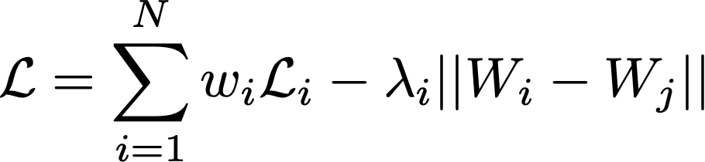
Soft parameter sharing
One model per task
The models parameters are regularized to encourage similar parameters
Used in language processing (learning one language with a lot of data helps learning another language with less data) to learn common tasks but not exact word translation*
W = model weigths
*Duong, L., Cohn, T., Bird, S., & Cook, P. (2015). Low Resource Dependency Parsing: Cross-lingual Parameter Sharing in a Neural Network Parser. Proceedings of the 53rd Annual Meeting of the Association for Computational Linguistics and the 7th International Joint Conference on Natural Language Processing (Short Papers), 845–850

Slide 35
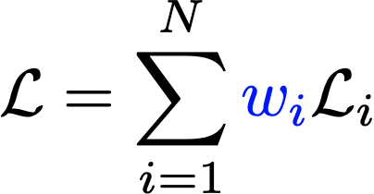
Balancing task importances

Slide 36
Why we need task balancing
Tasks loss
Some tasks are easier to learn than others
Tasks loss
TASK A
TASK B
time
They end up dominating the learning process

Slide 37
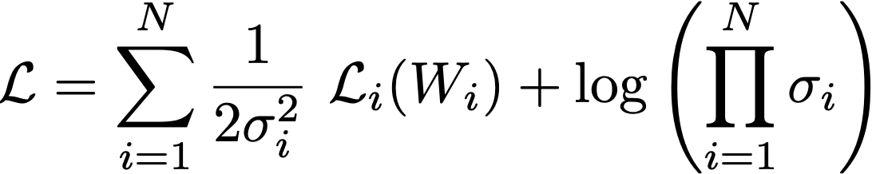
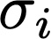

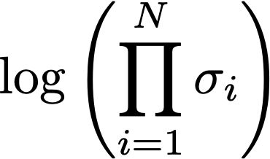
loss balancing with uncertainty
Each task relative weight is adjusted as the uncertainty of this task
Acts as noise regularizer
Kendall, A., Gal, Y., & Cipolla, R. (2017). Multi-Task Learning Using Uncertainty to Weigh Losses for Scene Geometry and Semantics. Retrieved from http://arxiv.org/abs/1705.07115

Slide 38
loss balancing using GradNorm
Gradient normalisation
Tasks loss
L_{A}(t)
TASK A
L_{B}(t)
TASK B
time
Chen, Z., Badrinarayanan, V., Lee, C.-Y., & Rabinovich, A. (2017), GradNorm: Gradient Normalization for Adaptive Loss Balancing in Deep Multitask Networks, arXiv e-prints, arXiv:1711.02257.

Slide 39
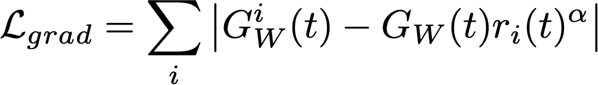
loss balancing using GradNorm
Gradient normalisation
Tasks losses are weigthed by the differences of gradients between tasks
→ A faster learning task will become hard to learn so others have time to adjust
Tasks loss
L_{A}(t)
TASK A
L_{B}(t)
TASK B
G^{i}_{W} = gradient norm of task i
G_{w} = average gradient norm
r_{i} = relative training rate
α = restoring force strength
time
Chen, Z., Badrinarayanan, V., Lee, C.-Y., & Rabinovich, A. (2017), GradNorm: Gradient Normalization for Adaptive Loss Balancing in Deep Multitask Networks, arXiv e-prints, arXiv:1711.02257.

Slide 40
loss balancing using Pareto MTL
Gradient normalisation
Chen, Z., Badrinarayanan, V., Lee, C.-Y., & Rabinovich, A. (2017), GradNorm: Gradient Normalization for Adaptive Loss Balancing in Deep Multitask Networks, arXiv e-prints, arXiv:1711.02257.

Slide 41
Attention mechanisms
Gradient normalisation
Chen, Z., Badrinarayanan, V., Lee, C.-Y., & Rabinovich, A. (2017), GradNorm: Gradient Normalization for Adaptive Loss Balancing in Deep Multitask Networks, arXiv e-prints, arXiv:1711.02257.

Slide 42
Back to CTA

Slide 43
Alt
Az
E
Type

Slide 44
Alt
Az
E
Type
Starting from images: getting rid of the expert engineered features extraction

Slide 45
Alt
Az
E
Type
Starting from waveforms: end-to-end system (computationaly much heavier)

Slide 46
Well-suited problem for deep learning
Well-suited problem for multi-task learning

Slide 47
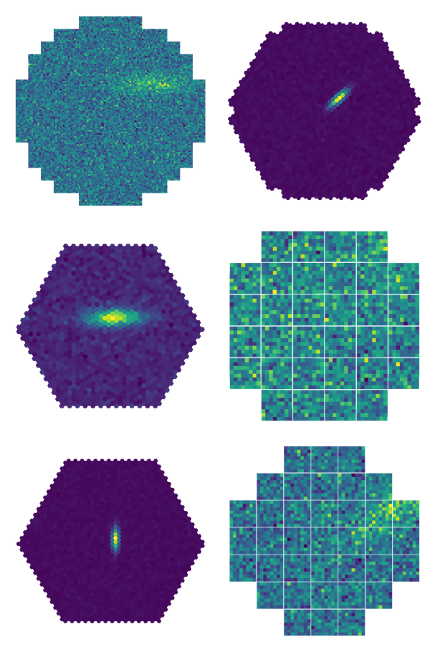

The hexagonal images and pixels issue
Question for the audience : How to apply convolution on that ?

Slide 48
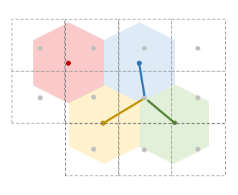
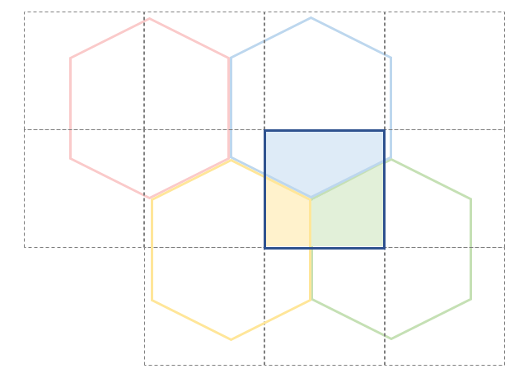
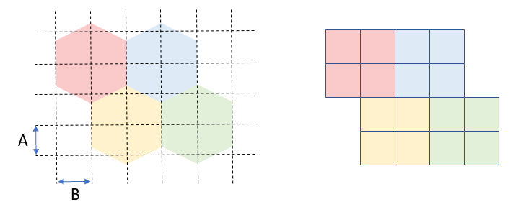
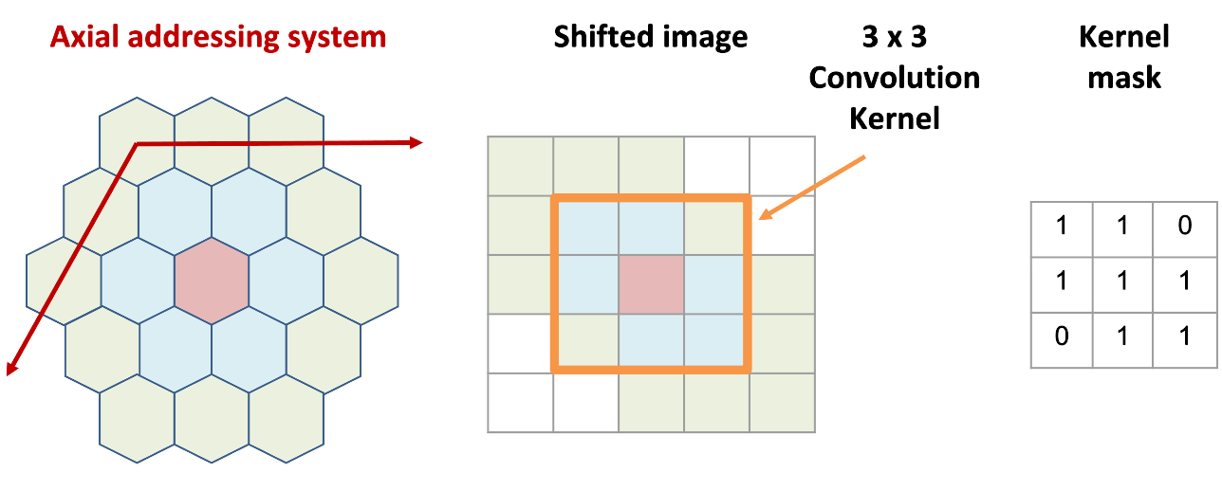
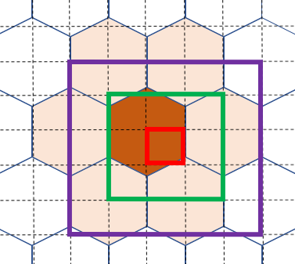
Going deeper
Hexagonal pixel processing with deep learning
Resampling: oversampling, rebinning, interpolation
Image shifting + masked convolution
1170 « fake » pixels (LST)

Slide 49

Indexed convolutions
True hexagonal neighborhood
Convolution for arbitrary lattices
Respects the true neighborhood
Avoids image distortion
Less parameters to train
Based on GEMM implementation of convolution
Convolution → matrix multiplication
im2col operation to select pixel based on the list of neighbors
1
2
3
4
5
6
7
8
9
10
11
12
13
14
15
16
17
18
19
im2col
5
6
9
10
11
14
15
...

Slide 50
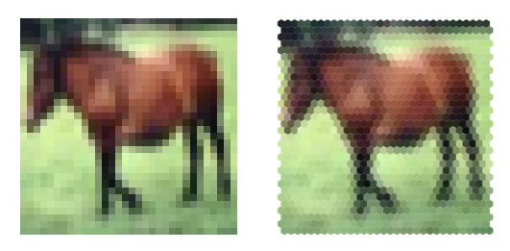

Indexed convolutions
Validation on CIFAR-10 (reference data set)
Hexagonal pixel vs square pixels
No significant difference
Implementation optimization needed
No preprocessing
Original image
Interpolated image
CIFAR-10 performance
 | Hexagonal kernels (i.c.) | Square kernels
Classification accuracy | 88.51 ± 0.21 | 88.39 ± 0.48
Find the open-source code at:
Jacquemont, M.; Antiga, L.; Vuillaume, T.; Silvestri, G.; Benoit, A.; Lambert, P. and Maurin, G. (2019). Indexed Operations for Non-rectangular Lattices Applied to Convolutional Neural Networks. In Proceedings of the 14th International Joint Conference on Computer Vision, Imaging and Computer Graphics Theory and Applications - Volume 5: VISAPP, ISBN 978-989-758-354-4, pages 362-371. DOI: 10.5220/0007364303620371

Slide 51
DEMO #2
See notebook deep_multi

Slide 52









Supported by the European Commission Framework Programme Horizon 2020 Research and Innovation action under grant agreement n. 653477 and n. 824064.

Slide 53
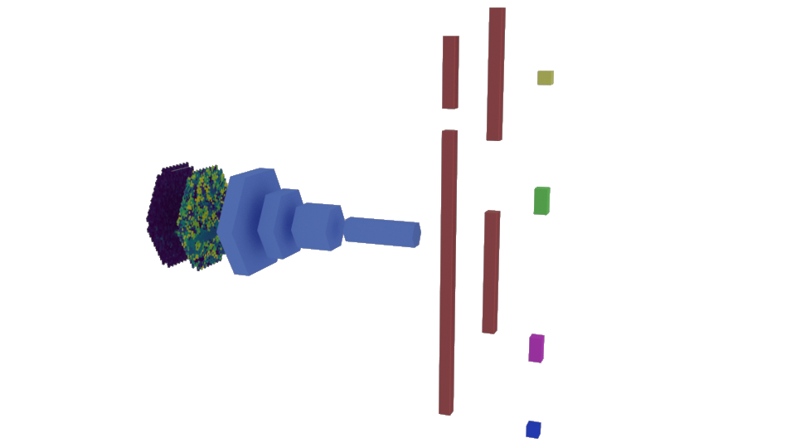
GammaLearn - γPhysNet
Energy
Full event reconstruction for LST1 data
multitask learning (hard parameter sharing)
Input = 2 channels = charges + temporal map
Indexed Convolution
Physically guided (global vs local features)
Masked loss
Uncertainty task balancing
Global pool
Impact
flatten
Direction
Convolutional block
Adapted from ResNet46
Particle type
Fully Connected layers
Multi-Task Architecture with Attention for Imaging Atmospheric Cherenkov Telescope Data Analysis, VISAPP 2021, M. Jacquemont et al 2021
*M. Jacquemont’s thesis

Slide 54
GammaLearn - classification
Multitask advantage: γPhysNet vs single task classifier
 | AUC | Precision | Recall
ResNet-56 | 0.954±0.001 | 0.956±0.001 | 0.942±0.001
γ-PhysNet | 0.960±0.002 | 0.957±0.003 | 0.956±0.006
Better recall → Keep more gammas
*M. Jacquemont’s thesis

Slide 55
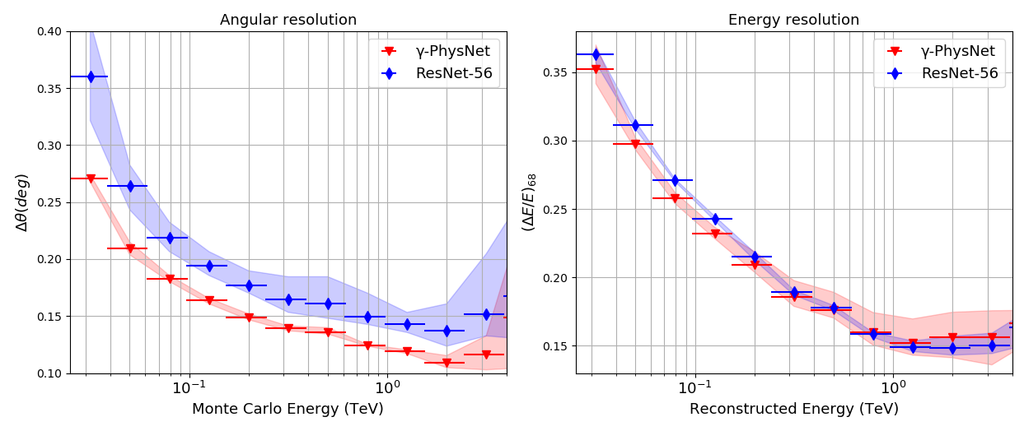
GammaLearn - regression
Multitask advantage: γPhysNet vs single task regressor
Lower
Is
better
Significant improvement on the direction reconstruction
*M. Jacquemont’s thesis

Slide 56
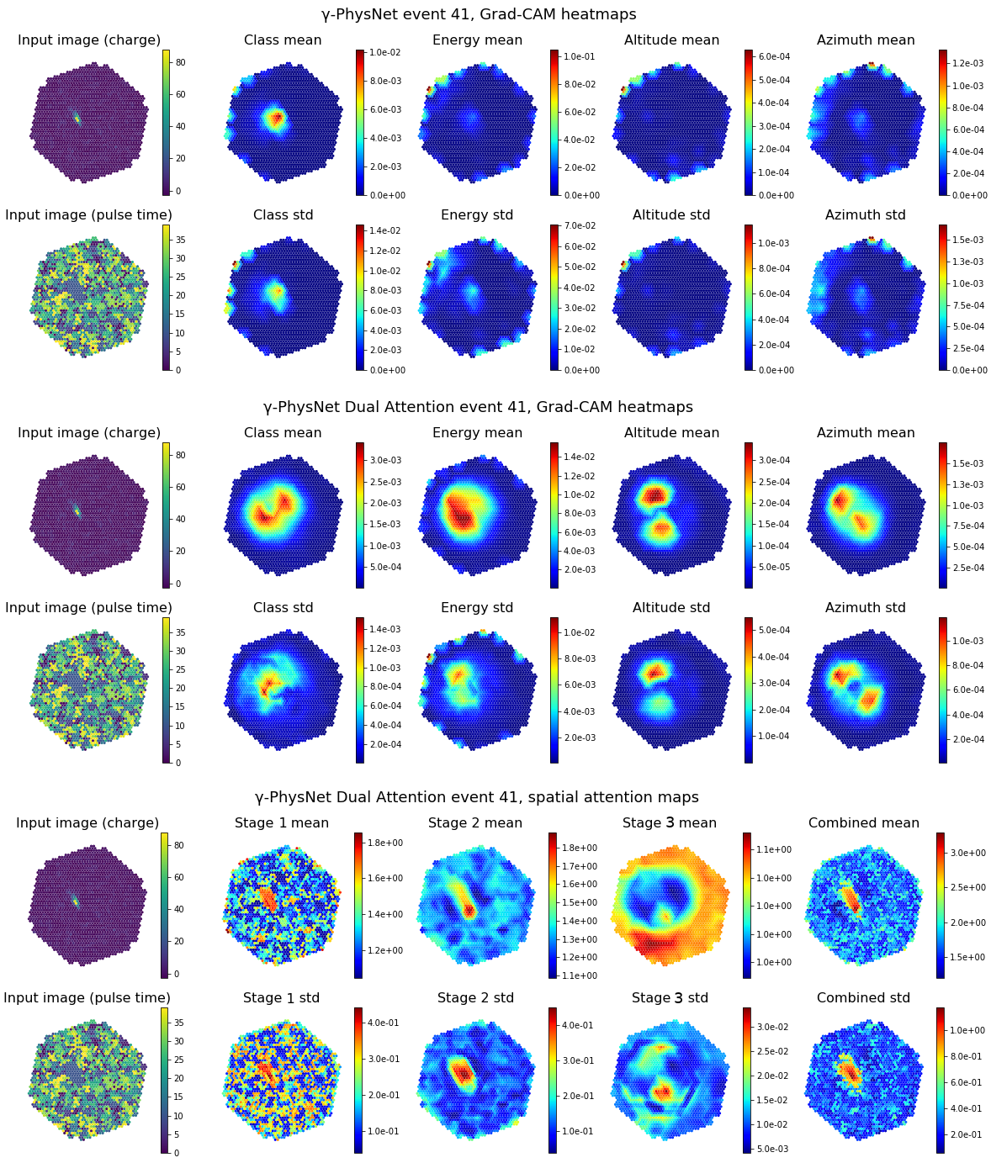
Attention please!
Without
attention
With
attention
Deep Learning for Astrophysics, Understanding the Impact of Attention on Variability Induced by Parameter Initialization, EDL-AI ICPR 2020 workshop, M. Jaquemont et al 2020

Slide 57
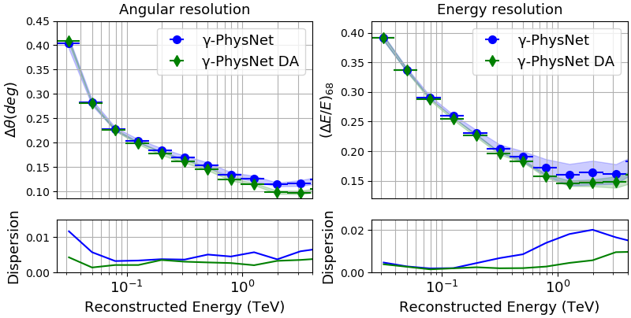
GammaLearn - regression
Attention advantage on γPhysNet
Lower
Is
better
m dispersion k robustness
*M. Jacquemont’s thesis

Slide 58
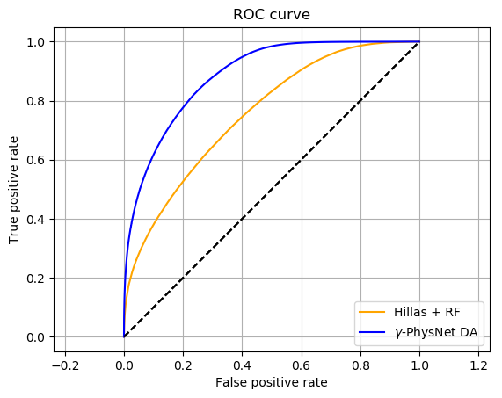
Comparison with standard analysis
 | AUC | Precision | Recall | Gammaness cut
Hillas + RF | 0.756 | 0.977 | 0.099 | 0.770
γ-PhysNet DA | 0.887 | 0.981 | 0.277 | 0.948
γ-PhysNet DA
Slightly better precision
Better recall
Better overall performance
Multi-Task Architecture with Attention for Imaging Atmospheric Cherenkov Telescope Data Analysis, VISAPP 2021, M. Jacquemont et al 2021
*M. Jacquemont’s thesis

Slide 59
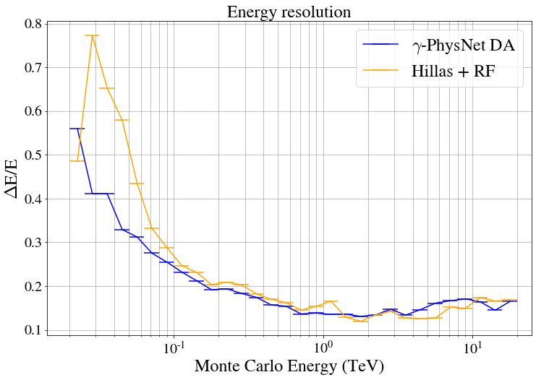
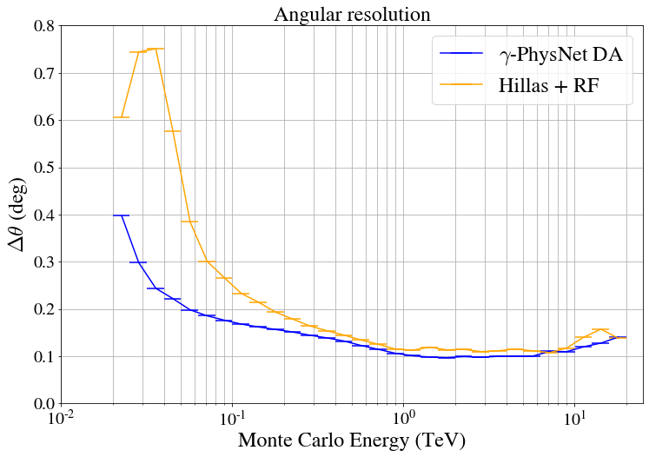
Comparison with standard analysis
γ-PhysNet DA is significantly better at low energies
Multi-Task Architecture with Attention for Imaging Atmospheric Cherenkov Telescope Data Analysis, VISAPP 2021, M. Jacquemont et al 2021
*M. Jacquemont’s thesis

Slide 60
More to come ! Currently working on assessing the sensitivity gain on real data…

Slide 61
Some important points not covered here…
What we covered today:
What is multitask learning
How it is implemented with a real use-case: Imaging Atmospheric Cherenkov telescopes event reconstruction
Important points not covered today:
Stereoscopy : merging prediction from each telescope in CTA
More complex deep multitask learning are being ivnented these days where the structure itself of the network and thus the relation between the tasks is learnt

Slide 62
Some useful references
Sebastian Ruder (2017). An Overview of Multi-Task Learning in Deep Neural Networks. arXiv preprint arXiv:1706.05098.
https://www.coursera.org/lecture/machine-learning-projects/multi-task-learning-l9zia
Baxter, J. (1997). A Bayesian/information theoretic model of learning to learn via multiple task sampling. Machine Learning, 28, 7–39. Retrieved from http://link.springer.com/article/10.1023/A:1007327622663
Zhanpeng Zhang, Ping Luo, Chen Change Loy, et al. “Facial Landmark Detection by Deep Multi-task Learning”. In: Computer Vision — ECCV 2014: 13th European Conference, Zurich, Switzerland, Cham: Springer International Publishing, 2014, pp. 94–108.

